Slide 1
IBM HR Analytics💼
Employee Attrition & Performance
Kalpit Kishore

Slide 2
Business Understanding & Overview
Employee attrition creates a significant operational and financial burden by draining productivity, institutional knowledge, and team morale. This overview examines the root causes of employee turnover—including excessive overtime, early-career flight risks, compensation gaps, and professional stagnation. By uncovering these patterns through data analysis, our goal is to help leadership shift from reactive exits to proactive retention strategies that safeguard workforce stability and drive long-term business success.

Slide 3
Kalpit Kishore
Understanding the data

Slide 4
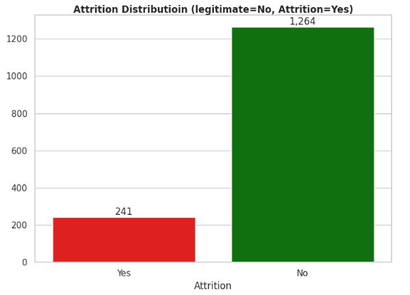
Target Variable
Findings
Overall Workforce Retention: The vast majority of employees stayed with the company, with 1,264 employees (83.99%) recorded as "No" for attrition.
Overall Attrition Volume: A total of 241 employees (16.01%) left the organization ("Yes")
Severe Class Imbalance: The dataset exhibits a significant 5:1 class imbalance between retained employees and those who left.

Slide 5
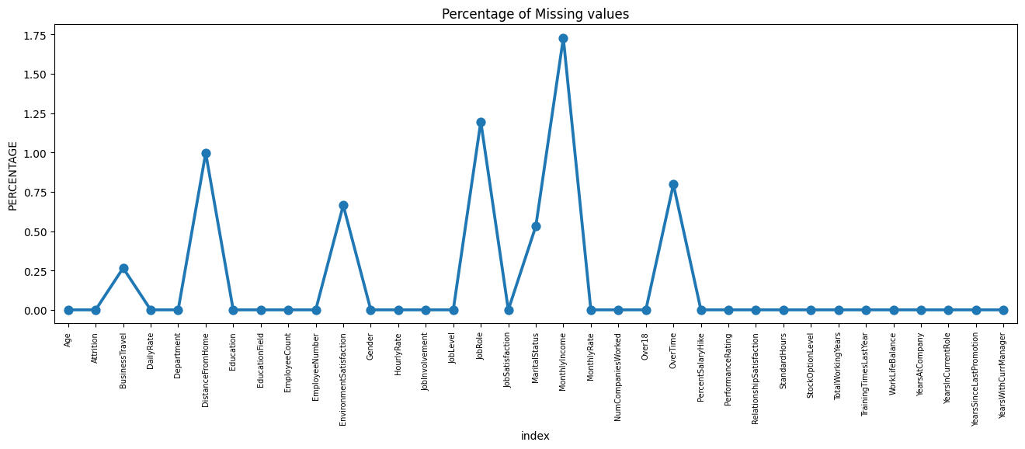
Missing Data
Findings
Overall Low Missingness: The vast majority of columns have 0.0% missing values, indicating a remarkably complete dataset overall.
Minimal Missing Percentages: For the few columns that do have missing data, the percentage of missing values is extremely low—ranging between 0.25% and 1.75%.
Most Impacted Features: MonthlyIncome has the highest percentage of missing values at roughly 1.73%, followed by JobRole at approximately 1.2%, and DistanceFromHome at 1.0%. Other minor gaps appear in features like OverTime, EnvironmentSatisfaction, and MaritalStatus.
Portfolio Action: Because missingness is very sparse (under 2%), these columns can easily be handled via standard imputation (e.g., median/mode) or by safely dropping the few missing rows without risking significant data loss or bias.

Slide 6
Kalpit Kishore
Categorical Analysis

Slide 7
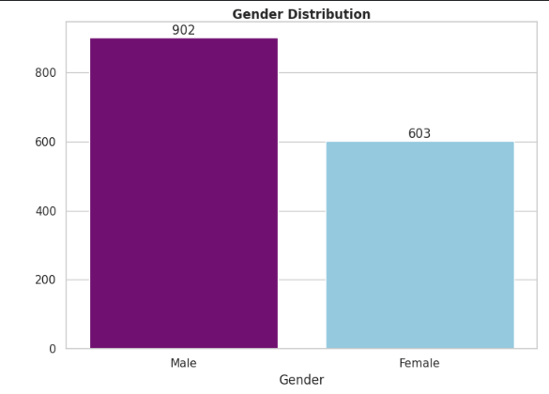
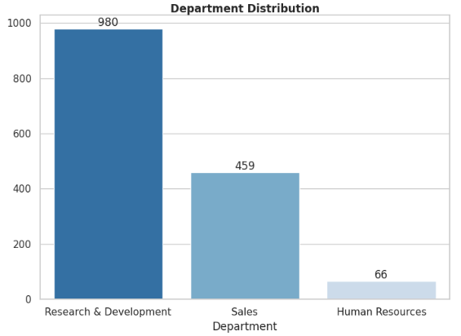
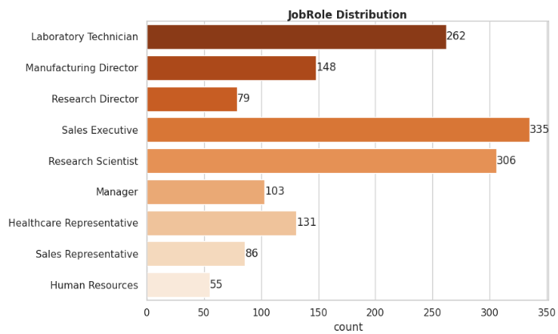
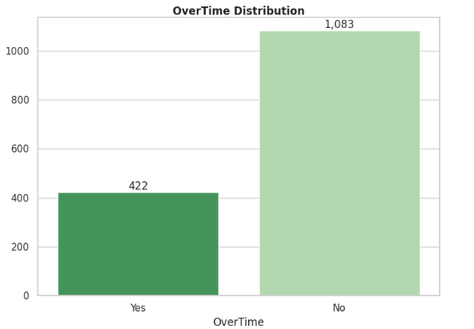
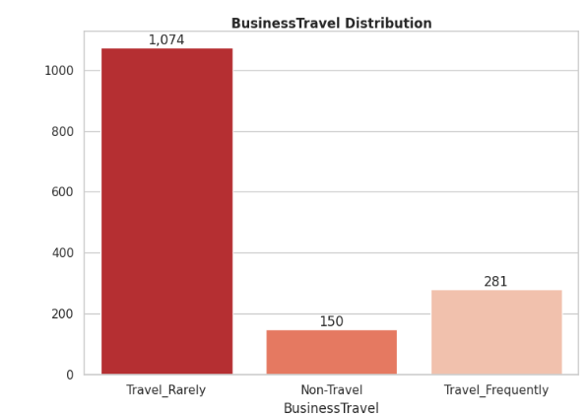
Univariate Analysis
Findings
The workforce is predominantly male (60%) and heavily concentrated in Research & Development (980 employees), with Sales Executive and Research Scientist being the top job roles. Notably, 28% of employees (422) work regular overtime, presenting a key operational factor to watch for burnout, while 71% travel rarely for business.

Slide 8
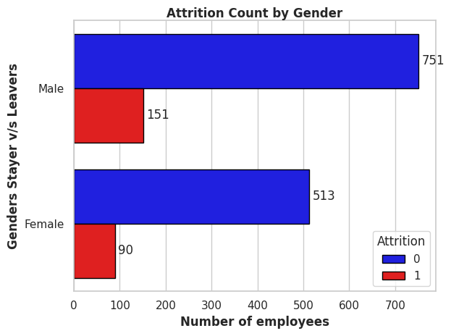
Attrition Count by Gender Category
Findings
The workforce is predominantly male, comprising 59.9% (902) of total employees compared to 40.1% (603) female employees.
In male category, it has almost 16.74% attrition rate and in female category, it is 14.92% attrition rate.
As per this data, we can say that we need to analyse the data more so that we can get more useful insights because on just gender categories we know male are more leaving but we need to know the root cause.
Let’s deep dive into it and find some useful insights…….

Slide 9
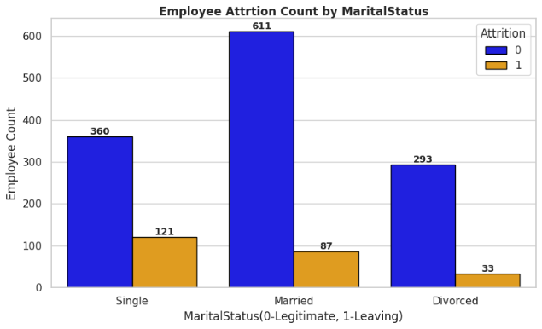
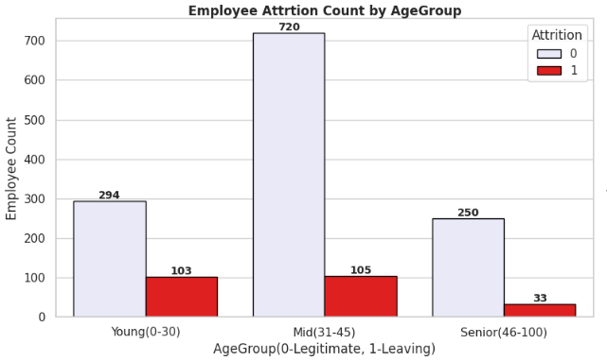
Attrition Count by AgeGroup & MaritalStatus
Findings
High-Risk Demographic: Employees who are single or younger (aged 18–30) exhibit the highest attrition rates in the organization.
Single employees have 25.10% attrition rate and young(18-30) employees have 25.9% attrition rate.
Core Insight: Both groups show nearly identical elevated exit rates, indicating that early-career and single employees are significantly more prone to leaving compared to older or married peers.
In conclusion, we need to care about these employees and provide more opportunities.

Slide 10
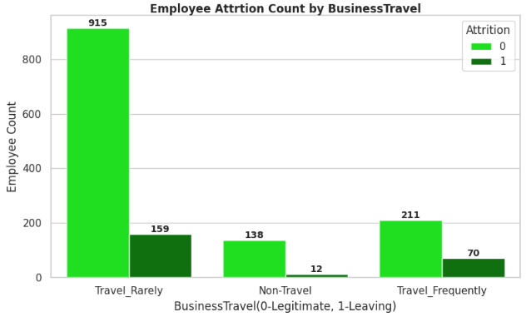
Attrition Count by Business Travel
Findings
As per BusinessTravel Category, it is quite visible that Travel_Frequently employees are more prone to leaving (24.91% rate).
As per the data, almost 70 employees are left out of 281 employees.
To reduce it, we need to check with the employee’s satisfactions and feedbacks so that we can understand the more clearly why they are leaving.

Slide 11
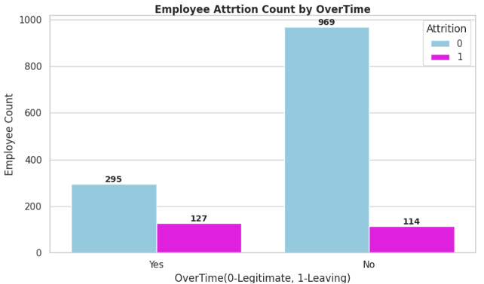
Attrition Count by OverTime
Findings:
As per the data, almost 422 employees are working overtime.
Employee Attrition count can be seen easily and understood that employee who is working overtime, are more likely to be leavers.
Almost 30.09% attrition rate on those people who are working overtime.
In conclusion, we should appraise those people and treat them as valuable people.

Slide 12
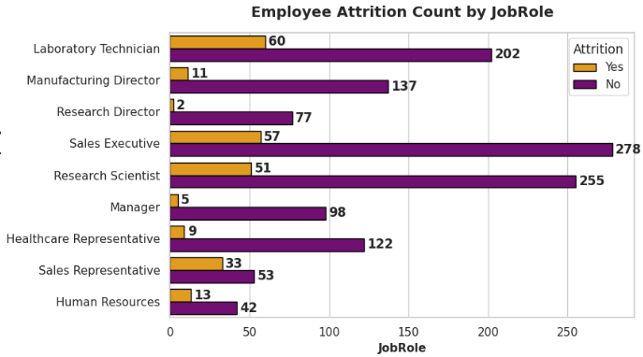
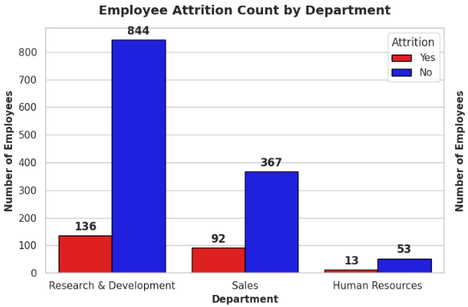
Attrition Count by Department & JobRole
Findings:
As per given data, we can see that in department category, sales department has high attrition rate almost 20.69%. In JobRole category, sales representative has high attrition rate almost 38.37%.
We can see other job roles and departments to see the attrition rates like in human resources.
In conclusion, we need to check sales category so that we can handle these leavers.

Slide 13
Kalpit Kishore
Numerical Analysis

Slide 14
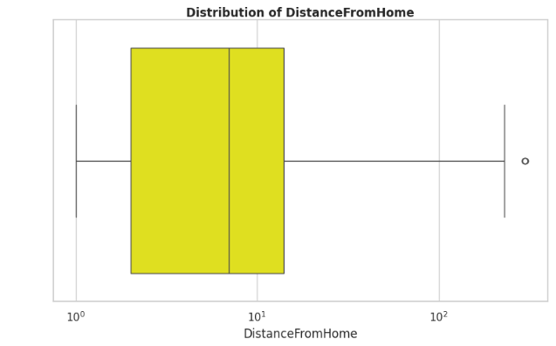
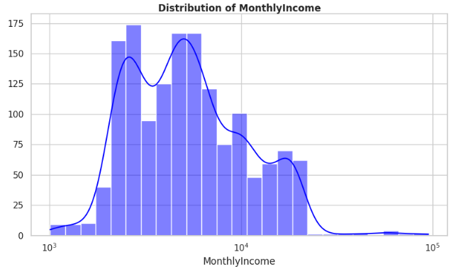
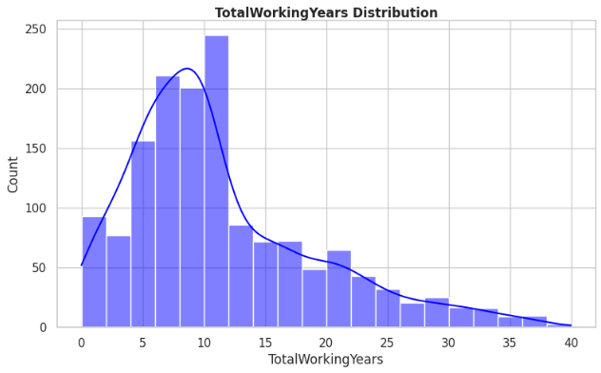
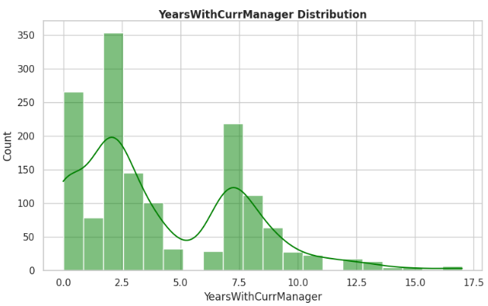
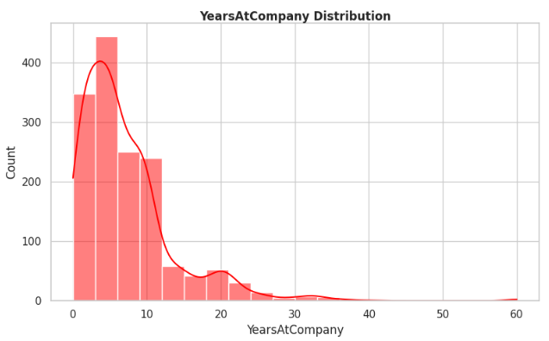
Univariate Analysis
Findings:
The numerical distributions show a heavily early-career and entry-to-mid level workforce structure.
Most employees are concentrated in lower tenure brackets, with the majority under 10 total working years, less than 5 years at a company and under 3 years with their current manager. Correspondingly, compensation is right-skewed, with most staff earning lower-to-mid monthly incomes, while commute distances are mostly short-to-moderate though a few extreme commute outliers exist.
Let’s deep dive into it one by one….

Slide 15
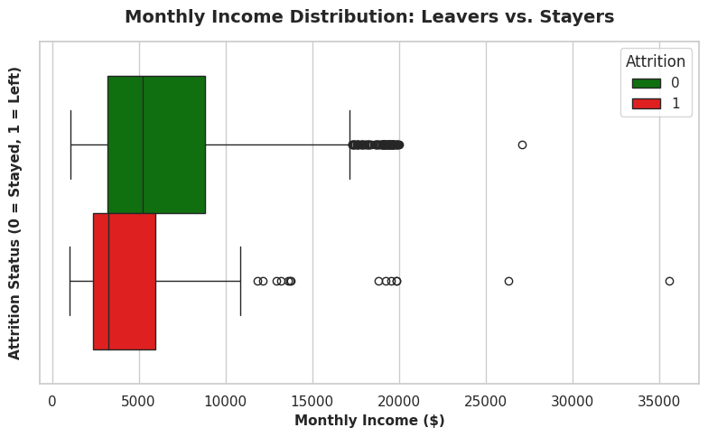
Attrition Count by Monthly Income
Findings
Income Gap: Employees who leave (Attrited = 1) have a significantly lower median monthly income (~$3,200) compared to retained employees (~$5,200).
High-Risk Band: Over 75% of leavers earn less than $6,000/month, with the densest concentration falling between $2,400 and $6,000.
Executive Outliers: High-income leavers (outliers ranging from $10,000 to over $35,000) represent senior/executive exits, which require separate retention strategies beyond base pay.
Strategic HR Takeaway: Address compensation competitiveness for entry and junior-level roles while creating transparent compensation milestones to prevent early-career turnover.

Slide 16
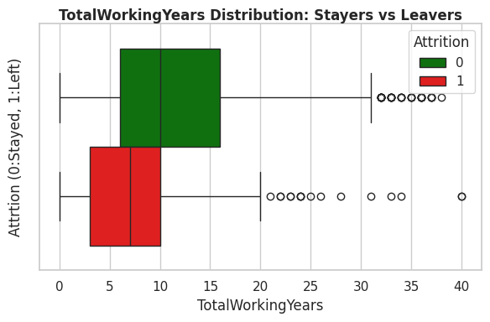
Attrition Count by TotalWorkingYears:
Findings:
Employees who leave (Attrition:1) have significantly lower median total working year (~7years) compared to retained employees (~10years).
Over 75% of leavers have less than 10 years experience, with densest concentration falling between 3 years and 10 years.
20+ years experience employees (outliers ranging from 20years to over 40years) represent that seniors/executives are exits.
Overall, we need to care about those leavers who have less experience and are leaving soon.

Slide 17
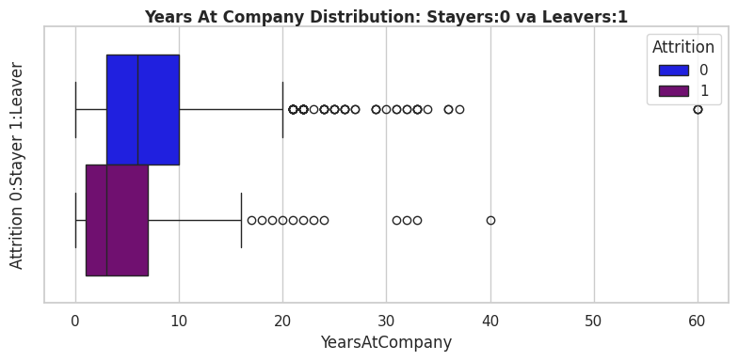
Attrition Count by YearsAtCompany
Findings:
Employees who leave (Attrition:1) have significantly lower median years at company (~3years) compared to the retained employees (~6years).
Over 75% leavers who have 7 years at the company, with the densest concentration falling between 1 year and 7 years
16+ years at the company (outliers ranging between 16years and 40years) represent that they might be retiring. They might be seniors/executives.
We need to take care about those people who have less than 7 years of experience at the company.

Slide 18
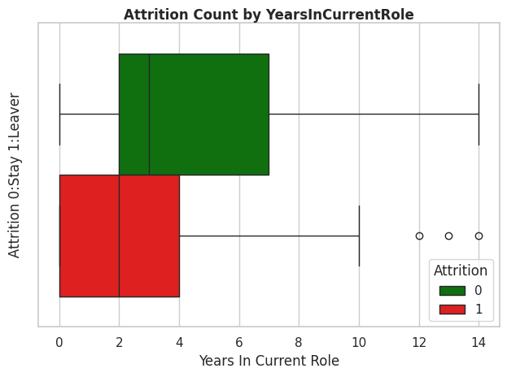
Attrition Count by YearsAtCurrRole
Findings:
Employees who leave (Attrition:1) have significantly lower median years in current role (~2years) compared to retained employees (~3years).
Over 75% leavers who have 4 years in current role, with the densest concentration falling between 1 year and 4 years.
In conclusion, we need to focus on our HR strategies and provide more opportunities and learning things to our employees who are in current role so that they can improve themselves and get better roles.

Slide 19
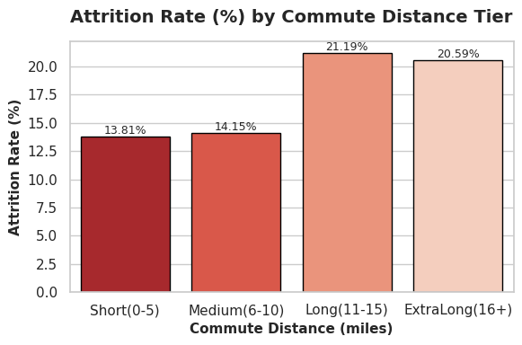
Attrition Count by DistanceFromHome
Findings:
Employees who leave have significantly higher commute distance (~11-15miles) almost 21.19%.
Over 75% employees are coming from 30miles distance as per the given data. In which we have higher attrition rate almost (20-22%) leavers who coming from 11miles to 16+ miles distance.
We need to focus on those employees who are coming from too far.
We can provide work from home or cab facilities for the employees to make worklifebalance.

Slide 20
Kalpit Kishore
Thank You

